Slide 1
SOCIETAL HUB by ByteBrewers
Aaimlik Abbasi 21i2540
TAHA Farooq 21i0550
Affan Anwar 21i2548

Slide 2
INTRODUCTION
This project aims to create a centralized platform for societies to streamline communication and provide easy access for users, members, and administrators to perform their respective duties efficiently.

Slide 3
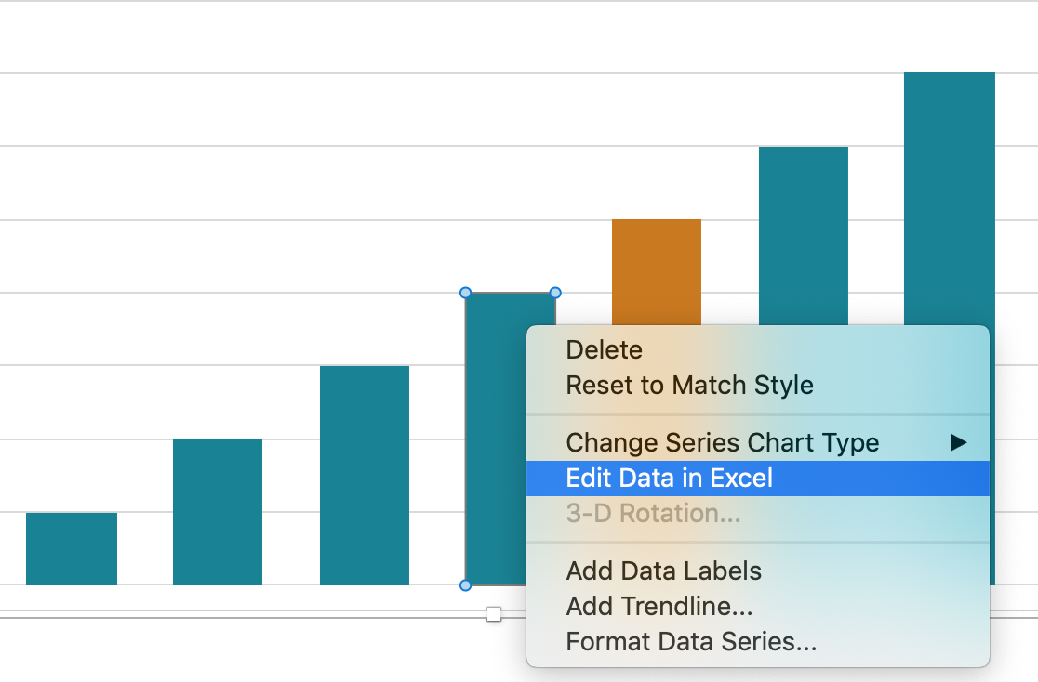
Project analysis slide 11
Advantages and Constraints
Advantage
It provide centralized platform for the society ensuring that admin and society can coordinate
Constraints
Too complex

Slide 4
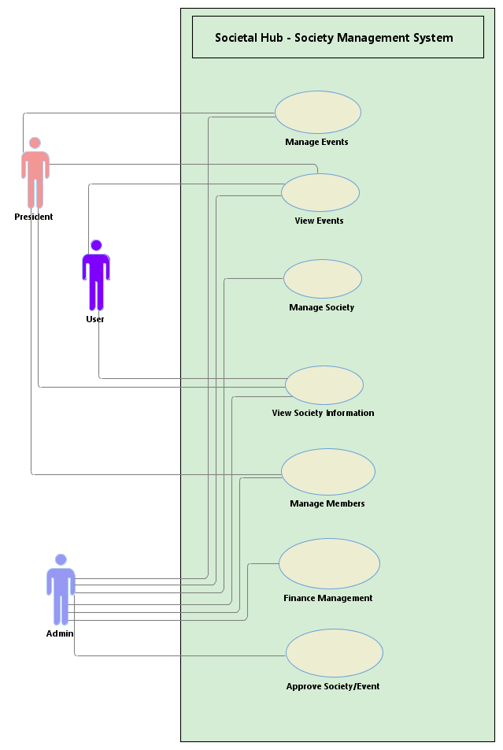
Project analysis slide 11
Design

Slide 5
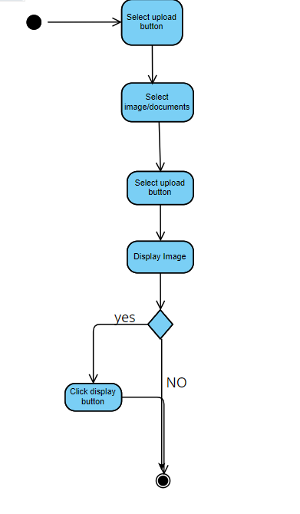
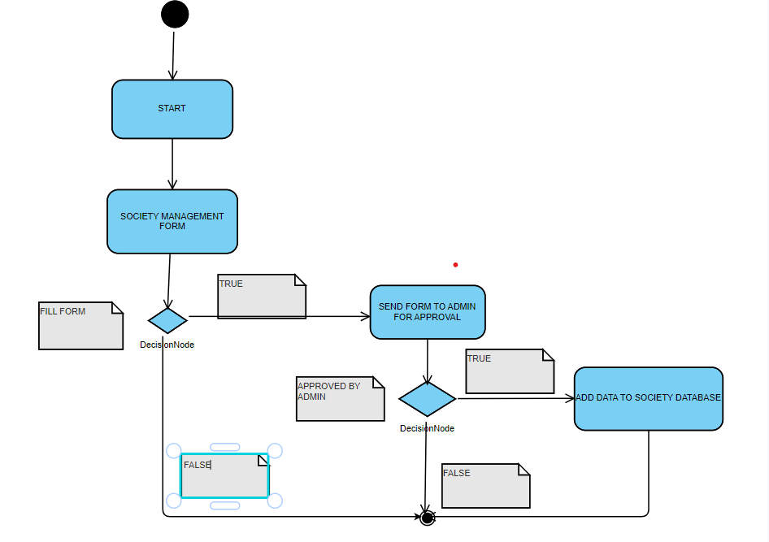
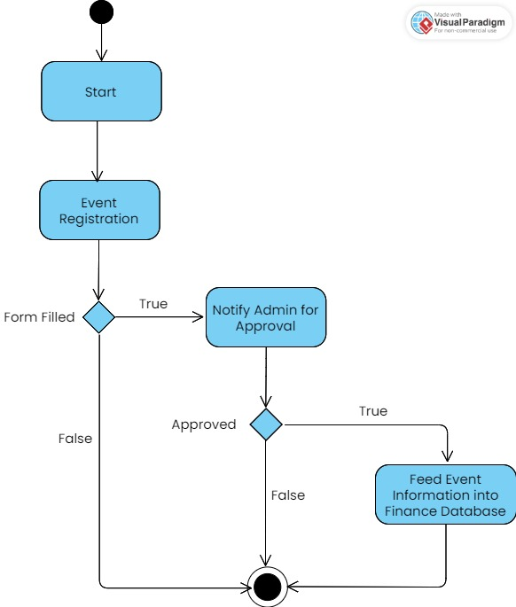
Project analysis slide 11
Activity Diagram

Slide 6
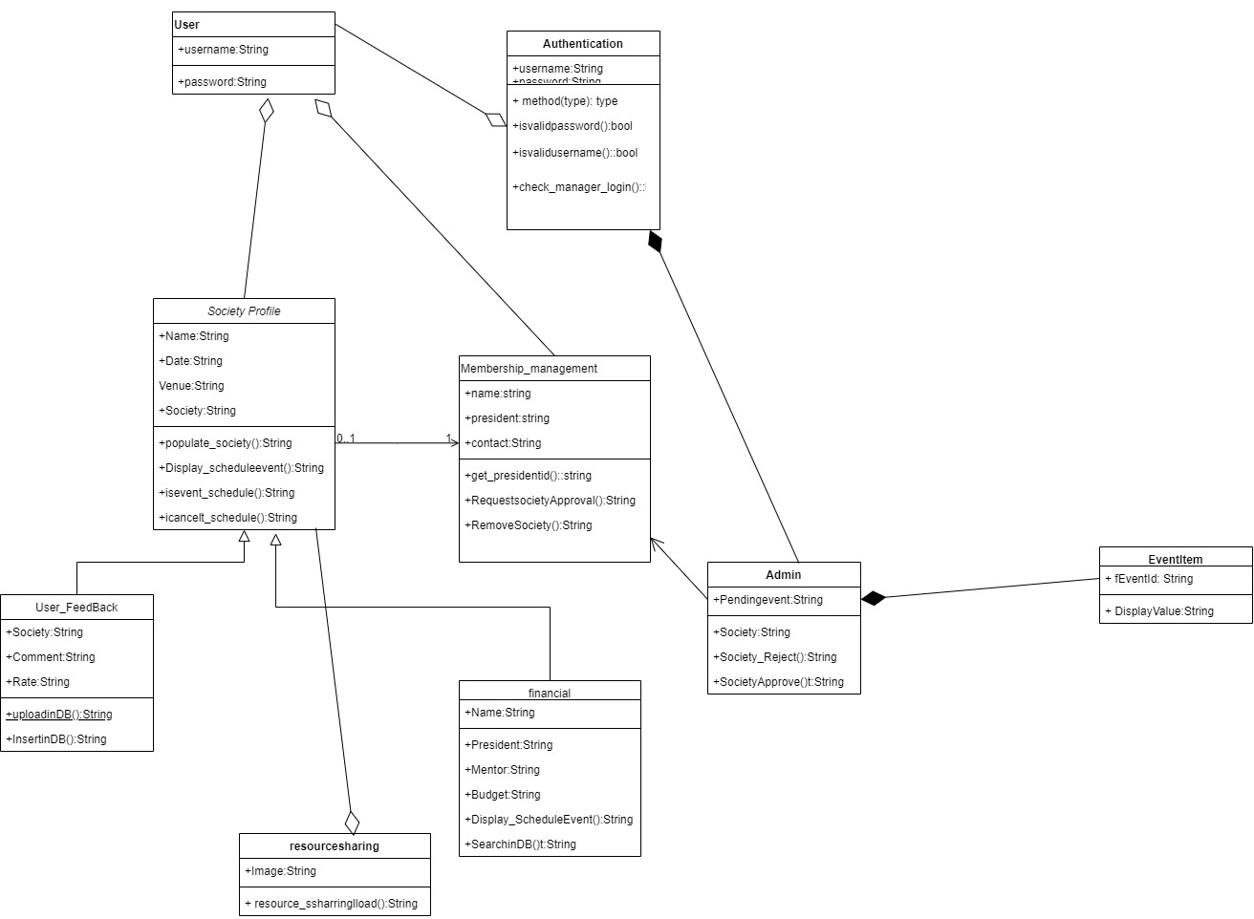
Project analysis slide 11
Class Diagram

Slide 7
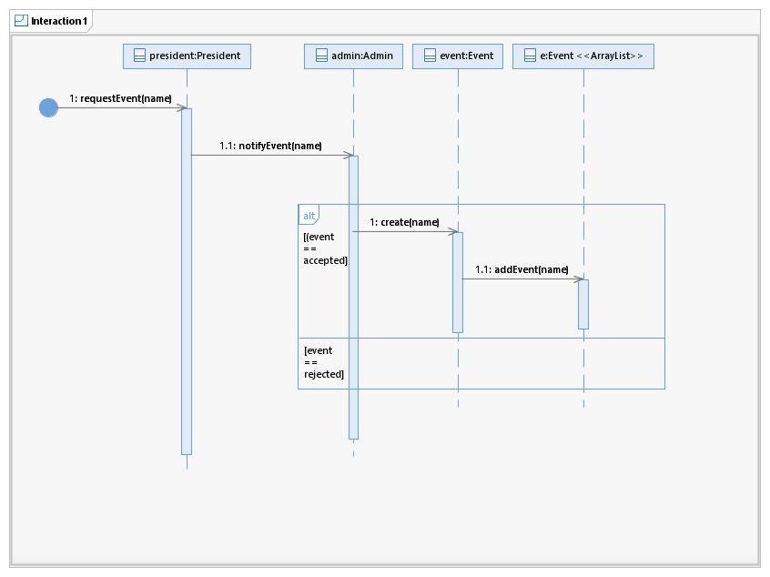
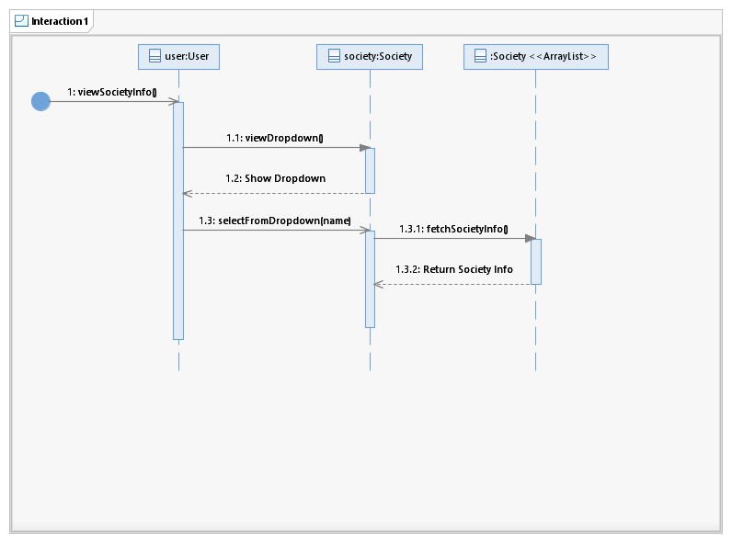
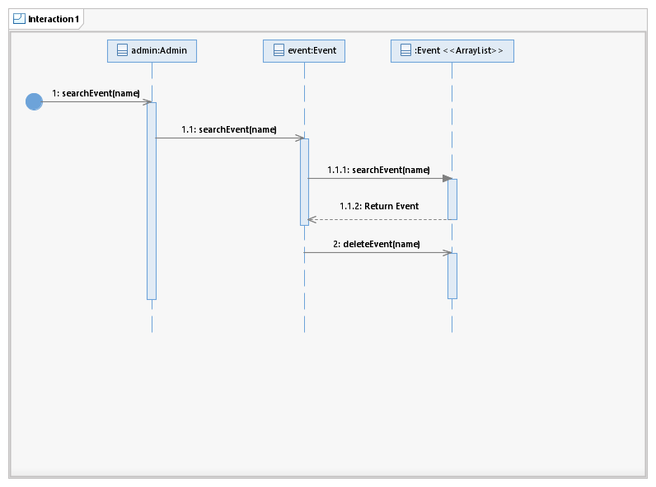
Project analysis slide 11
Sequence Diagram

Slide 8
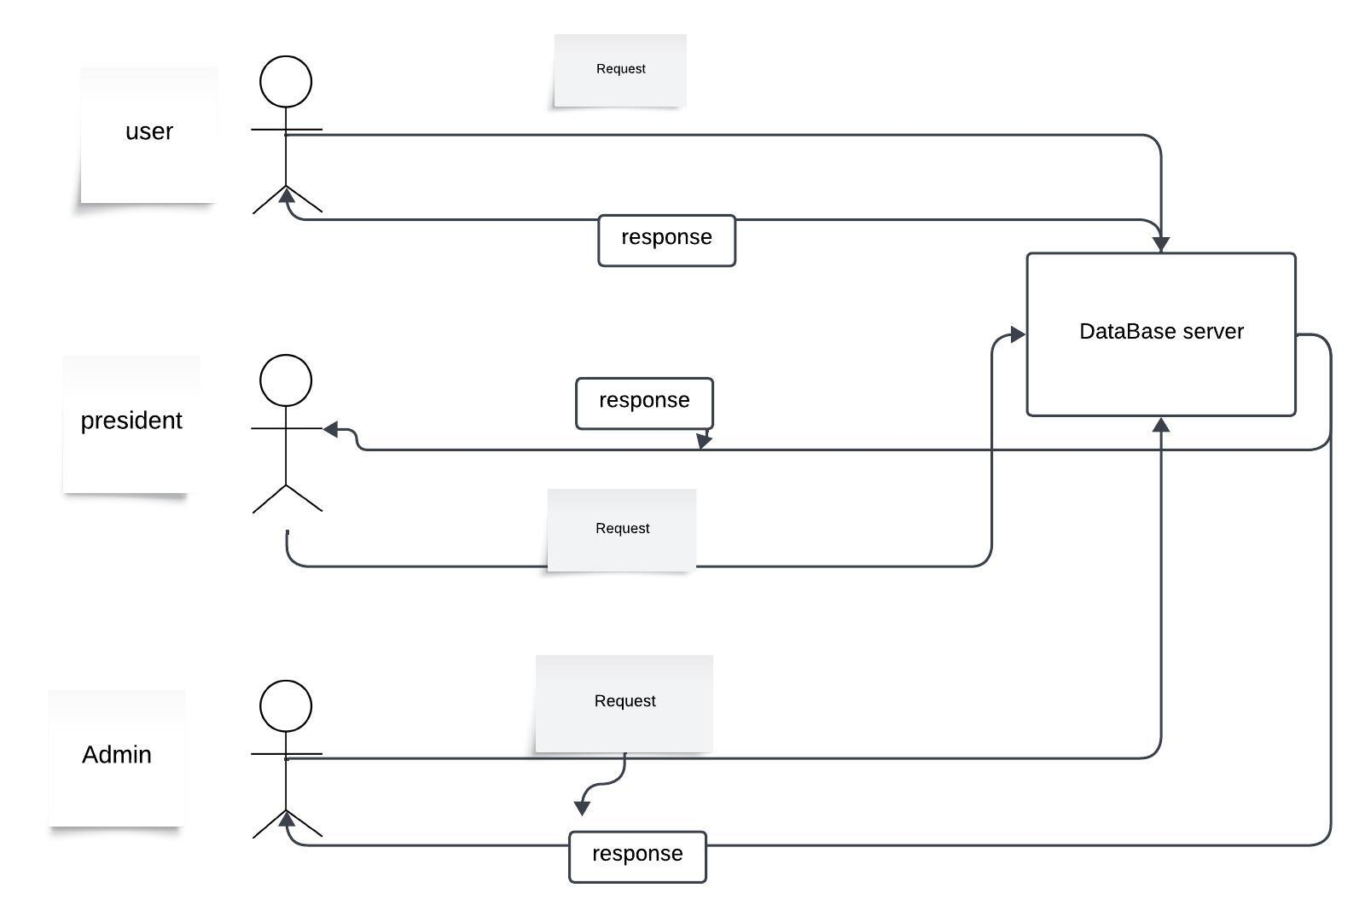
Project analysis slide 11
Architecture
Client -Server
The system used client and server architecture so multiple users can access data at the same time
Insert
Delete
Update

Slide 9
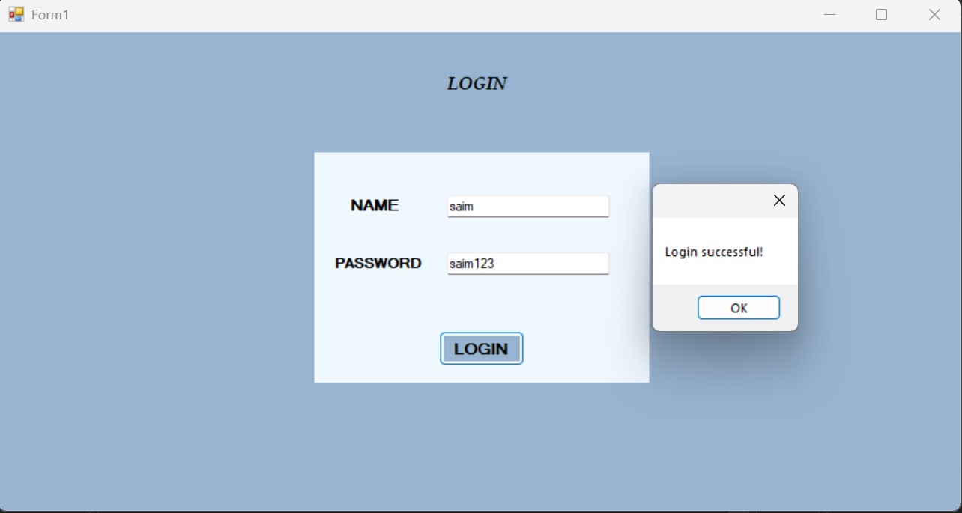
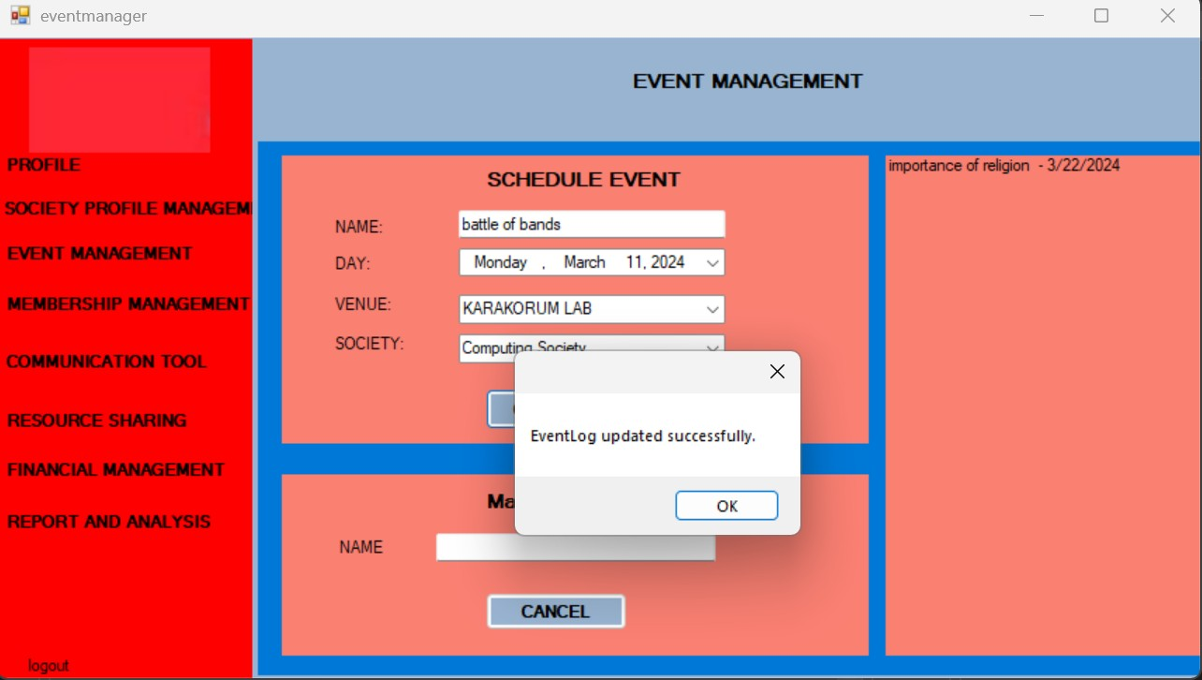
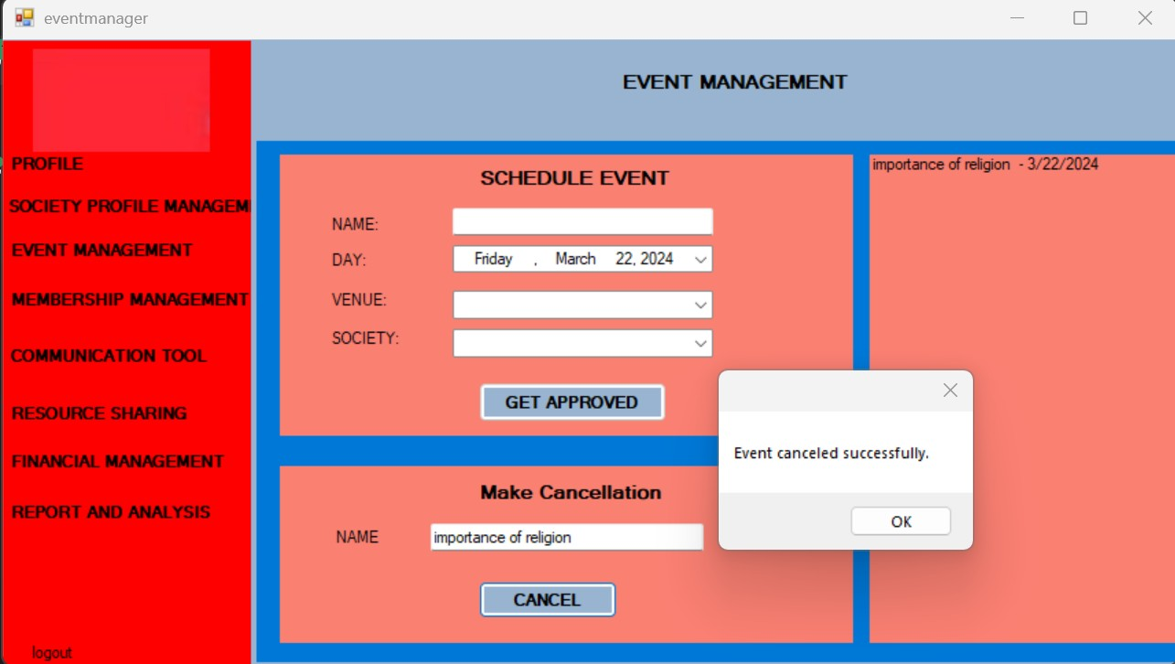
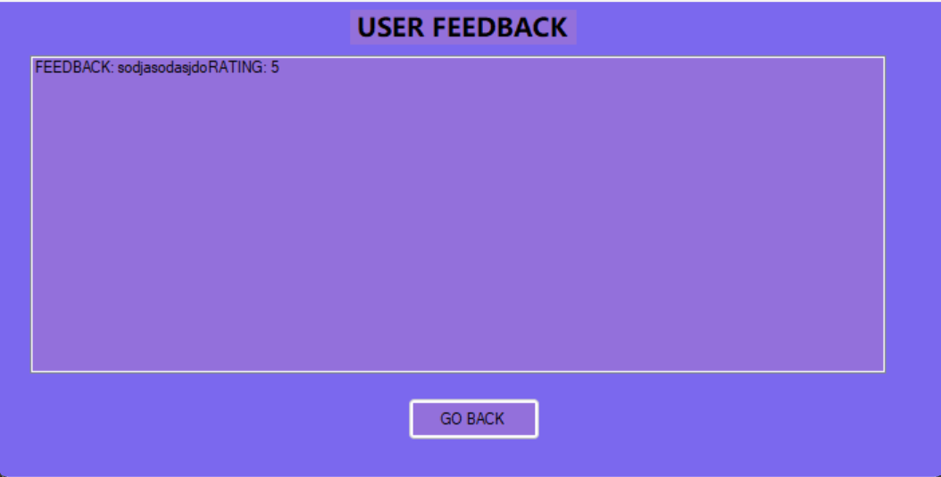
Project analysis slide 11
Implementation

Slide 10
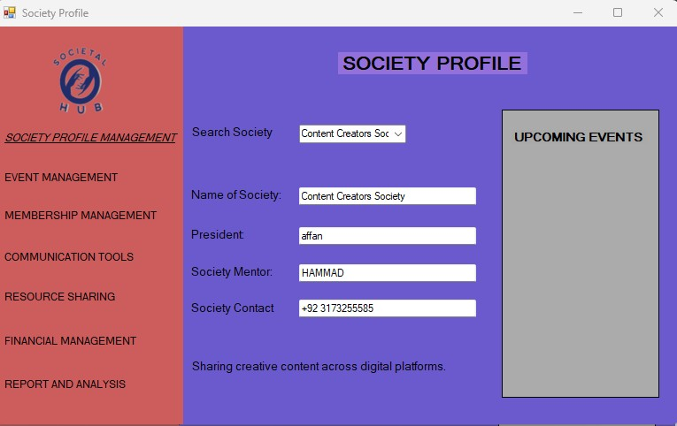
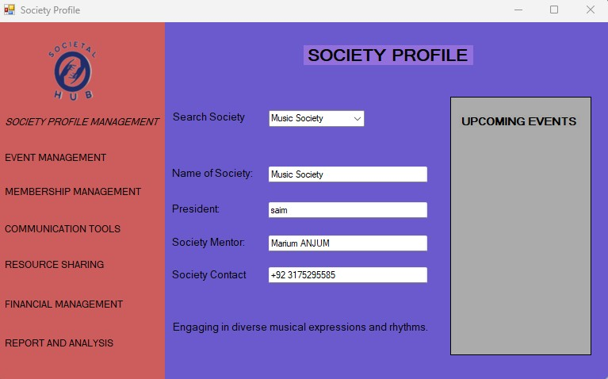
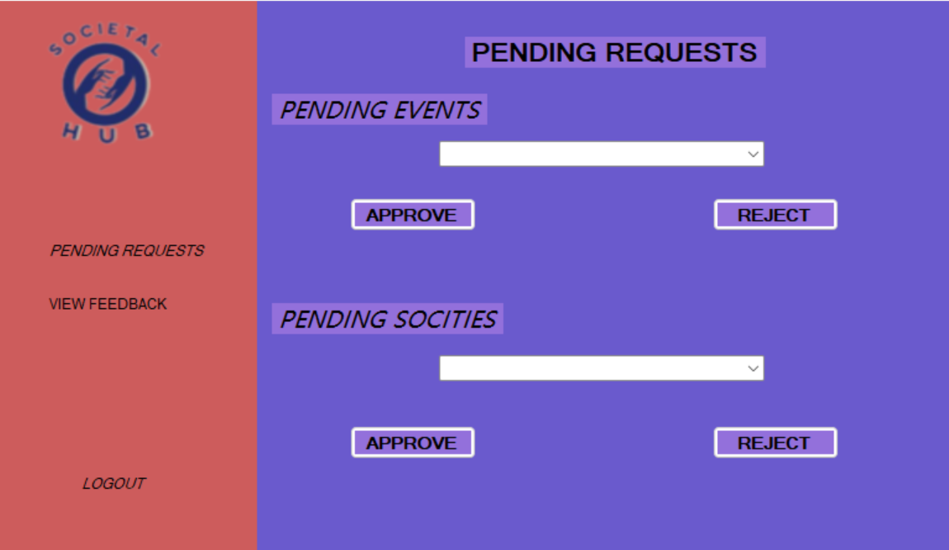
Project analysis slide 11
Implementation

Slide 11
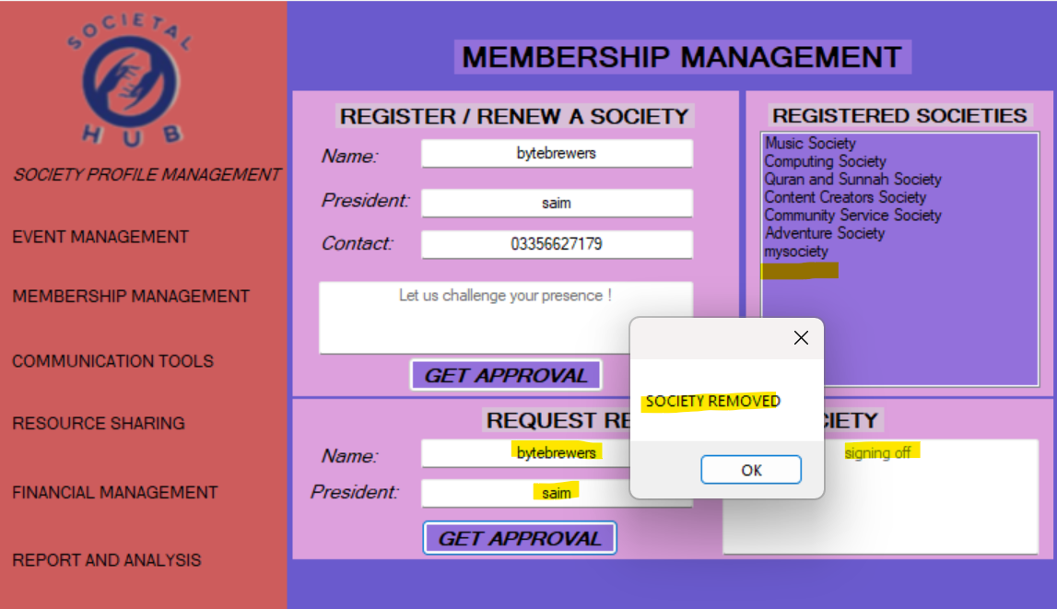
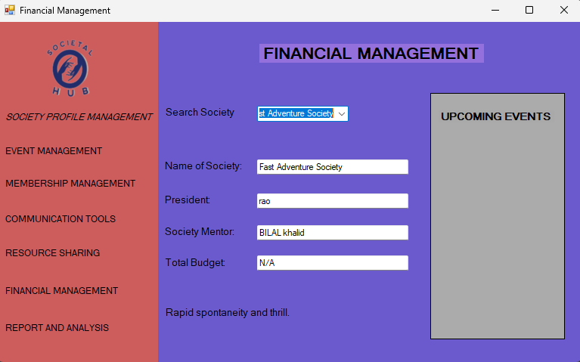
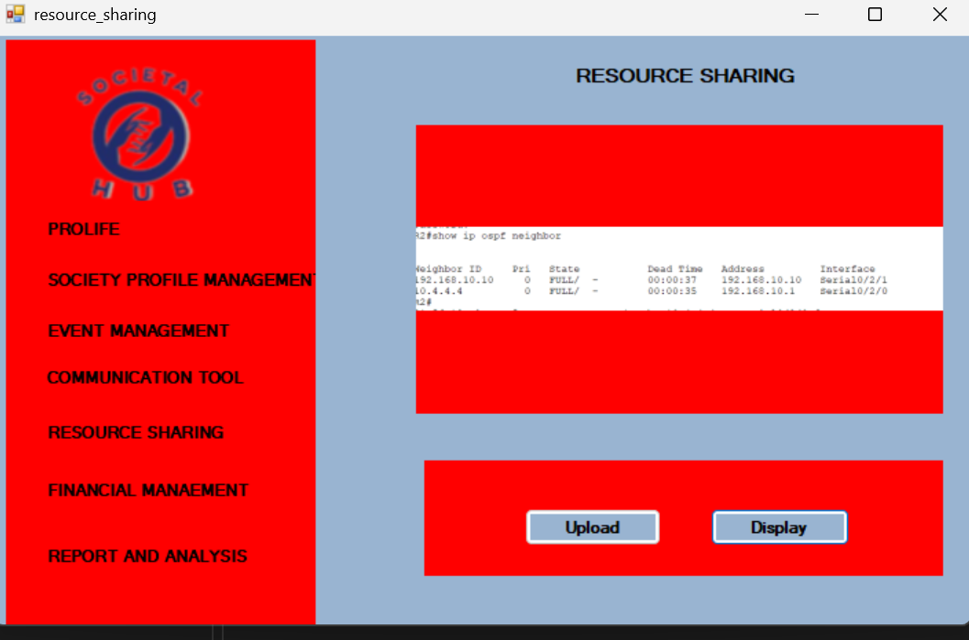
Project analysis slide 11
Implementation

Slide 12
Work Division
Aaimlik Abbasi:-
Resource sharing
Event management
Login
Class diagram
Architecture diagram
BVA
Affan Anwar:-
Initial UIs
Society Profile (Frontend)
3) Membership Management (Frontend + Backend)
Admin (Frontend + Backend)
Modular Integration
7) Activity Diagram
Taha Farooq:-
Team Agreement
Problem statement and Solution
Society Profile
Finance Management
User-side Feedback Management
Use-Case Diagram
Sequence Diagrams
Activity Diagram

Slide 13
Lesson learn
Documentation is just as important as implementation in software engineering process

Slide 14
Thank You

